Slide 1
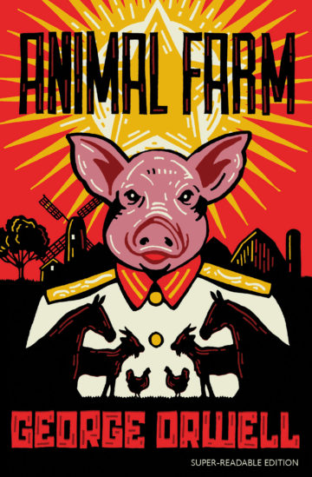
‘Animal Farm’ – George Orwell
Colour-Coded Notes on the Text:
Themed bullet points
Heinemann (NW) page numbers
Detailed analysis

Slide 2
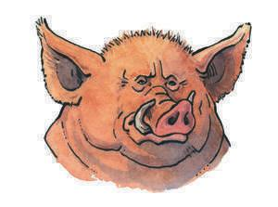
Chapter One – Old Major’s Dream
Bullet Points
* human malpractice
* persecution
Detailed analysis
pg.1
- The novel opens with the a rather unsavoury description of Mr Jones , the so-called proprietor of Manor Farm, whose actions are like those of a jailer rather than a caring farmer. Note the use of the verb 'locked' which highlights the fact that the animals are as good as imprisoned or enslaved. The suggestion is that Jones's methods of running the farm have become sloppy, careless, and he has become severely neglectful of his duties - he is not managing his affairs effectively and is only looking after his own interests. His drunken stupor lets us see that he has become insensitive towards the needs of others.

Slide 3
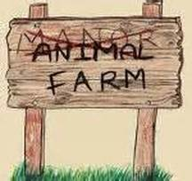
Chapter Two – The Rebellion
Bullet Points
* The death of the Dream
* The pigs plan in secret
Detailed analysis
pg.8
- With the death of Old Major comes the death of the dream as Old Major meant it. This chapter marks the start of the pigs' ruthless yet subtle take-over. They must seem to go along with Old Major's idealistic predictions, but at the same time plan to secure power. He is buried in an orchard but will his teachings become fruitful? They certainly will for the pigs!
pg.9
- There is something secretive being planned from the beginning, so the idea of equality does not exist from the word go. Orwell talks of 'secret activity' which seems to be conducted by the 'more intelligent animals.' The first thing which the pigs do to secure their power on the farm is to plan, to prepare, to enable themselves to benefit from this at a later date.

Slide 4
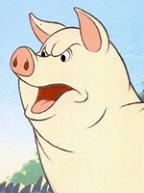
Chapter Three – Pigs Take Control
Bullet Points
* Animals are united
Detailed analysis
pg.16
- Note the use of the words 'toiled ans sweated' which is something they were subjected to in Jones's day, but here they feel pleasure in working for what they assume naively is for the sake of all of them. They are actually slaving away for the pigs' benefit alone. On the surface it looks as though the idea of equality can work as the animals are so committed to the cause apart from a few exceptions. The animals recognise nothing suspicious about the pigs' rule.

Slide 5
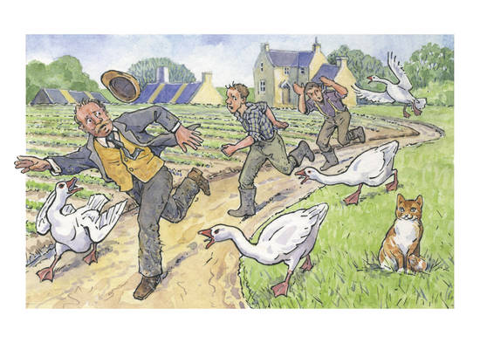
Chapter Four – Battle of the Cowshed
Bullet Points
* Short-lived unity
* Human enemies prolong unity
Detailed analysis
pg23-24
- This chapter starts with the feeling that Snowball and Napoleon are working together, both sending out flights of pigeons to spread the news of the rebellion, but this unity is short-lived. There is still a positive tone to the happenings.
- The deception that all is well on Animal Farm is sustained with the portrayals of the humans. They are really caricatures of generally unpleasant human beings. Jones is regarded as weak, a bore and a person who the other farmers have nothing but contempt for. The rivals Pilkington and Frederick hate each other almost as much as they hate Jones. However, the way they behave reminds us why the animals have rebelled.

Slide 6
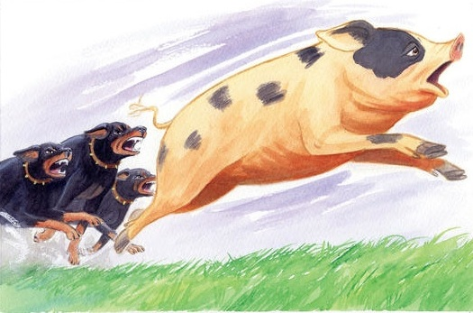
Chapter Five – Snowball’s Expulsion
Bullet Points
* Turning point of the fable
Detailed analysis
pg.28-29
- This chapter is really the turning point of the fable. The upward movement in the life of the animals has reached its peak and the slide downwards is about to begin. The chapter opens on a pessimistic note. Mollie defects to the side of the humans, and winter marks the beginning of great hardship. The weather in January is described as 'bitterly hard' and the ground is 'like iron.' The weather here, reinforced by the adverb, adjective and simile, symbolises the later hardship the animals are going to suffer under the forces of Napoleon and Squealer.

Slide 7
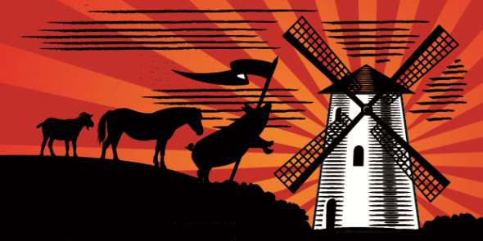
Chapter Six – Windmill Destroyed
Bullet Points
* Irony of the animals’ happiness
Detailed analysis
pg.37
- In the opening paragraph we are told that the animals are happy to work hard, and for such long hours because they are working for themselves, not for someone like a human who would exploit them. This, of course, is bitterly ironic. They cannot see that they are merely working for a new exploiter. Orwell makes this point clear by referring to 'strictly voluntary' work which, if not done, will result in a 50% reduction in their rations. This is tantamount to punishing them. This point is made again when one of the earlier agreed evils of working for humans is re-introduced : the giving up of the produce of their labour for sale. Napoleon's early conditioning is probably the reason for the animals' passive acceptance of the situation. Boxer's ever-increasing strength and willingness and Benjamin's taciturn refusal to share his thoughts no-one will protest.

Slide 8
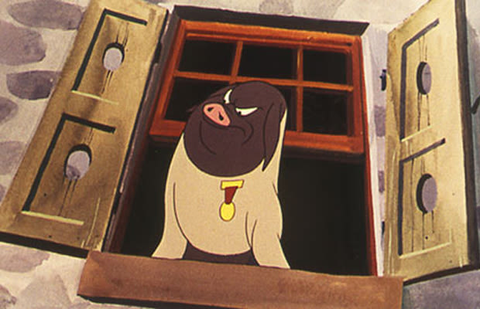
Chapter Seven – Napoleon’s Purges
Bullet Points
* The bitter weather reflects the animals’ lives
Detailed analysis
pg.45
- The bitter weather again reflects the hardship of the animals' lives. This is a classic example of pathetic fallacy. The knowledge that the outside world is watching them gives them good reason to work, to prove humanity wrong. In believing that the destruction of the windmill is down to the animals' inability to build it properly, the humans provide even more of an incentive to work. Where does their knowledge of what is being said about the farm coming from? We have some reason to believe that it is Squealer who is fuelling the animals with this information, in which case, its credibility is debatable.

Slide 9
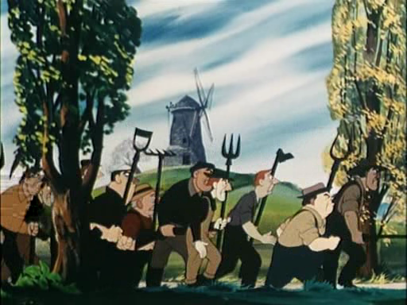
Chapter Eight – Battle of the Windmill
Bullet Points
* 6th commandment is adjusted
* Pigs’ use of statistics
Detailed analysis
pg.56
- This chapter opens with a further adjustment to the commandments ( the 6th) to justify actions which would have been forbidden in the original rules. The fact that the animals are satisfied with this irritates the reader again. After the pathos of the animals' position at the end of the last chapter we really expect something more of them, but they merely accept that there was 'good reason for killing the traitors.' Orwell is clever in his wording that the words 'without cause' had 'slipped out of the animals' memory.‘
- We cannot believe the figures that Squealer proudly and convincingly states. They have clearly been fabricated but there is nothing to prove him wrong. none of the animals is in a position to contradict him.

Slide 10
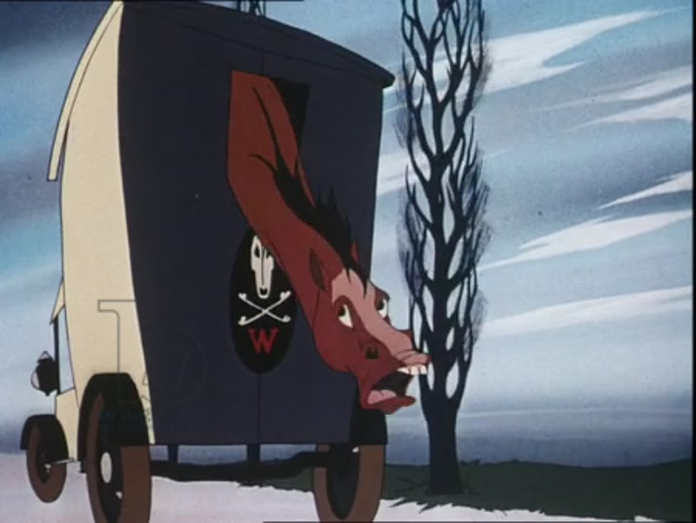
Chapter Nine – Boxer’s Demise
Bullet Points
* Boxer’s failing health
Detailed analysis
pg.69
- This chapter concentrates on two related aspects , Boxer's failing health and the subject of retirement. The first two paragraphs introduce both aspects. His wounds are taking a long time to heal but he is still working hard. He has clearly remembered the promise of retirement and this probably keeps up his spirits. He is nearly 12 years old - which is the same Old Major was when he died. Old Major dies fulfilled and pampered. Death is far from painless. His blinkered loyalty is now almost embarrassing but there is much pathos in the idea of living and dying for the Windmill which Boxer regards as a symbol of freedom. but which is really a symbol of oppression.

Slide 11
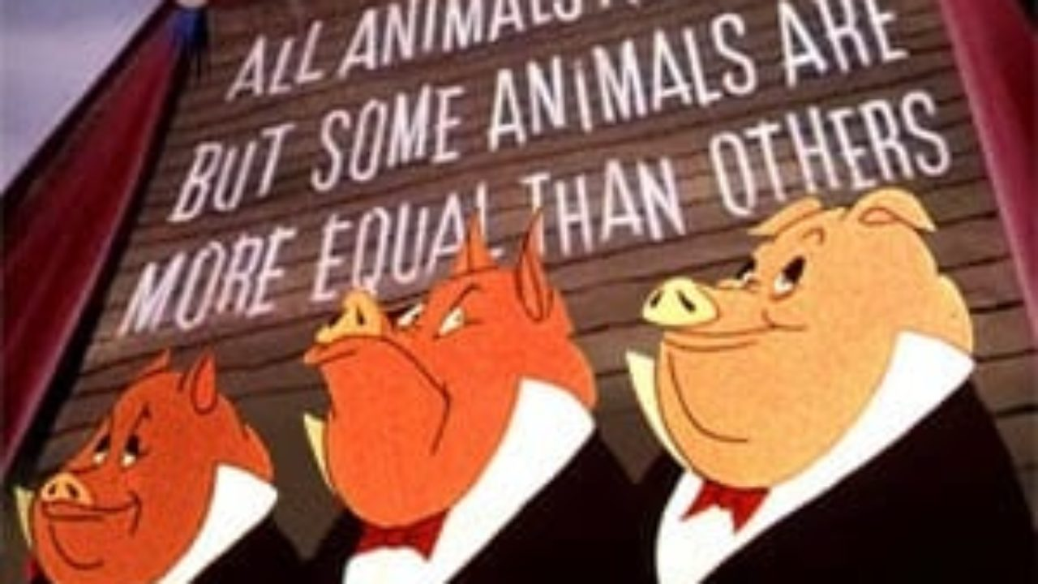
Chapter Ten – ‘Some Animals Are More Equal Than Others’
Bullet Points
* Passing of time
* Short lives
Detailed analysis
pg.79-80
- Note the change in time in this chapter. Time has previously passed in a continuous flow, season upon season. At the beginning of the final chapter, time has passed considerably. Time is seen as Napoleon's ally. As time has passed, he has gained greater control and has reconstructed the past to make it an ally also : "A time came there was no-one who remembered the old days of the rebellion" which was only a "dim tradition."
- We are reminded that the animals' lives are still "short". The speech which Old Major gave about the animals' lives being "miserable, laborious and short" has not changed. Things have come full circle. Benjamin reminds us that these are the true "unalterable laws of life." This unalterable law of life is the only thing which has not changed for the animals.

